Slide 1
I-CARE
Name : Shaina Katoch (TEIT-1/54)
Gaurang Kumbhar (TEIT-1/63)
Yamika Machhi (TEIT-1/66)
Date of presentation: 11/10/2022
Group No : 17
Atharva College of Engineering
Department of Information Technology

Slide 2
Content
Introduction
Review of literature
Existing System and Proposed System
Problem definition
Scope of project
Business Model
Methodology
Technology
Block Diagram
Implementation
UML/DFD
Flowchart
Result and Discussion
Conclusion
Reference
Future Scope

Slide 3
Introduction
The main aim of this project is to create a new Digital Health care ecosystem.
E-pharmacies integrated services bundling teleconsultation, diagnostics and medicine deliveries.
To provide people with the diagnoses of the disease, that would require to input the basic symptoms they are facing and would inform them about the disease they may be suffering from along with the probability of other diseases.
Clinical task, or “to-do” lists .

Slide 4
Review of literature
Title | Author | Year of Publication | Source | Findings
Healthcare goes mobile: Evolution of teleconsultation and e-pharmacy in new Normal | Sudarshan Jain | September 2020 | Ernst & Young LLP | Teleconsultation has always been a quick and simple way to reach your doctor. Most individuals can recount consulting their doctor on a phone, or using a network or video link like Facetime, WhatsApp or Zoom at some point.. This paper will put such issues in perspective and will use a consistent framework to highlight the role of pharmaceutical companies and other healthcare stakeholders to make teleconsultation scalable.

Slide 5
Title | Author | Year of Publication | Source | Findings
E Health Care using Centralized Health Management System | Mrs.Arthi CI Mrs.Priya RL | June 2016 | International Journal of Computer & Organization Trends (IJCOT) | The emergence of Centralized Health Database System provides patients and healthcare professionals easy accesses to information no matter where they are. According to a recent survey most patients say they are very interested in and capable of accessing healthcare information and services via a Web-based health system which provides an easy access to the medical information any time anywhere
Disease Prediction | Mr. A.D.Prajapati5 | May 2020 | IRJET | Disease Prediction system is based on predictive modeling predicts the disease of the user on the basis of the symptoms that user provides as an input to the system.

Slide 6
Existing System
1) Data loss: A lot of paperwork is required to keep the information of patients, doctors.
2) Time Wasting: Medical personnel takes time in sorting out patients file or record.
3) Tedious: It is tedious because it has to take a routine.
4) Processing velocity: very low processing speed resulting in low production.
5) Late Attendance: It usually takes a while to see a doctor or a nurse because of the population

Slide 7
Proposed System
The Healthcare Management System is a web-based application system that an administrator uses as an alternative means of keeping the doctors record, patient’s medical record and patient’s appointment with the doctor. The characteristics are as follows.
An applicant is permitted to log in with his/her username and password produced at the stage of registering.
ii. To view a specific patient’s information, the administrator is responsible to carry out such actions.

Slide 8
Problem Definition
In today’s age , mankind is being squeezed out due to anxiety, work patterns , etc. People fail to provide the required concern towards their health and other physical changes related to their body.
This project would help people overcome this situation by keeping a track of their daily health count , diet , past ailments , doorstep medicine delivery .
Moreover providing a perfect digital health care ecosystem to overcome their issues.

Slide 9
Scope of project
The business goal for the application is to provide the medicines to the people in the most cozy manner.
The proposed system aims to build an environment where various patients via their home can consult doctors, send their images, chat with doctors, tell them their issues and discuss remedies.
Provide Searching and reading diet plan ,reading daily health tips.

Slide 10
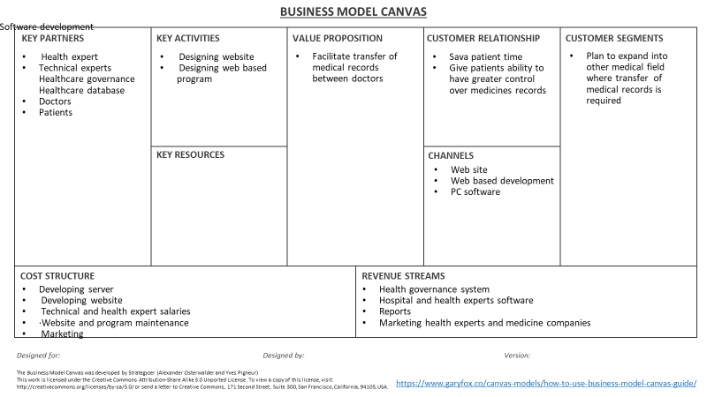
Business Model

Slide 11
Methodology
Healthcare management system was designed to automate the operations carried out in the healthcare environment using web development tool, which ensued each operation in the
healthcare environment. The healthcare management system was designed to automate the managing of patient’s record, medical record that will be stored in the database. The scheduling and booking of appointment was automated by the healthcare management system using the following tools:
i. Hypertext markup language (HTML)
ii. CSS
iii. JavaScript

Slide 12
Technology
Software Requirements Specification
Html
Css
Javascript
React
MySql
Firebase
Hardware Requirements Specification
Windows with 4gb Ram and 2 core processor
Storage: hard disk

Slide 13
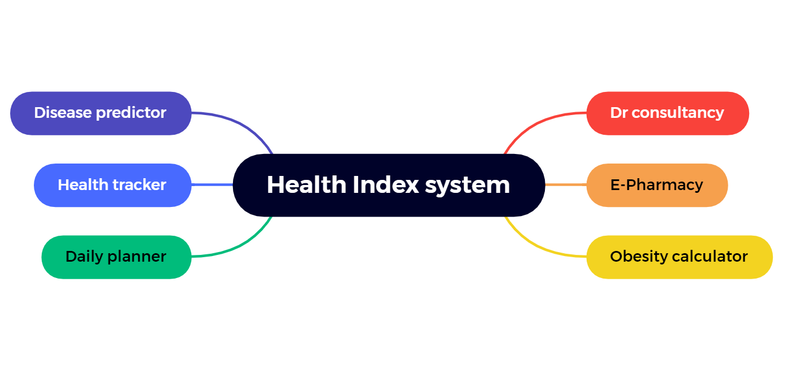
Block diagram
Fig : 1

Slide 14
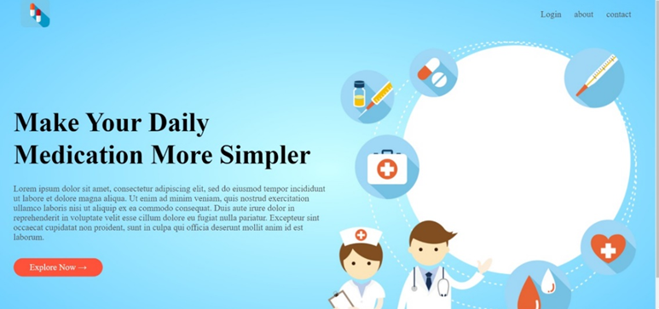
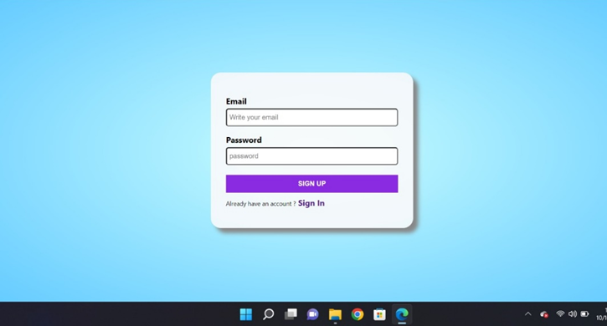
Implementation

Slide 15
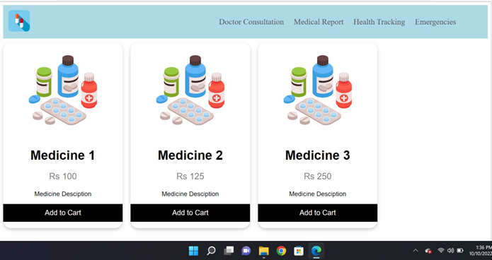
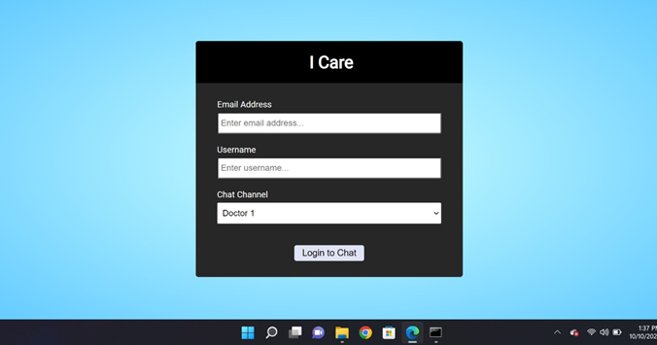
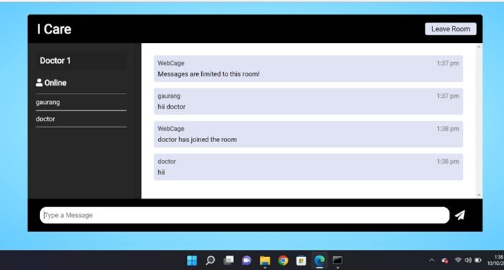

Slide 16
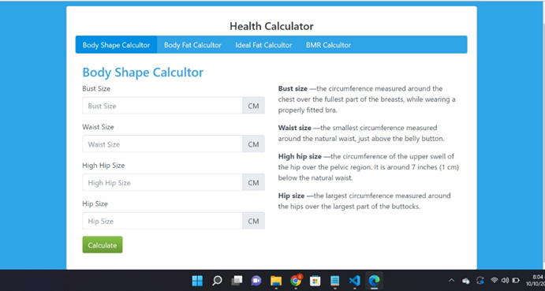
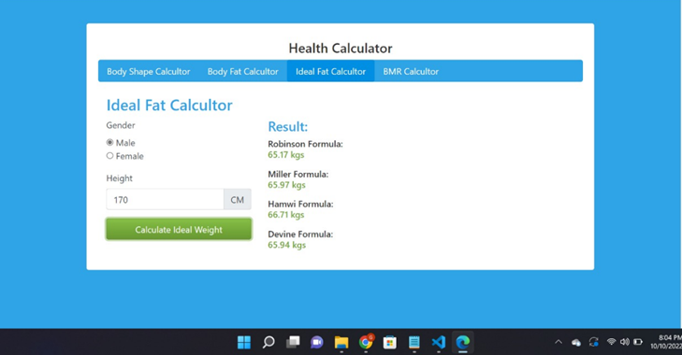
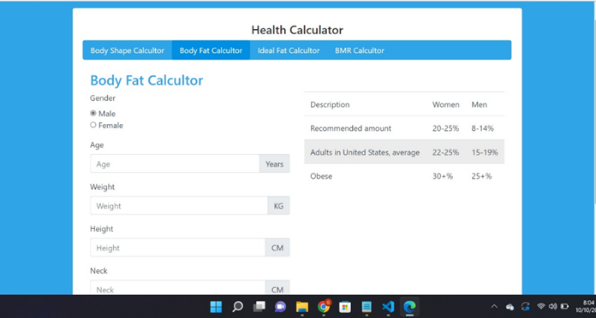
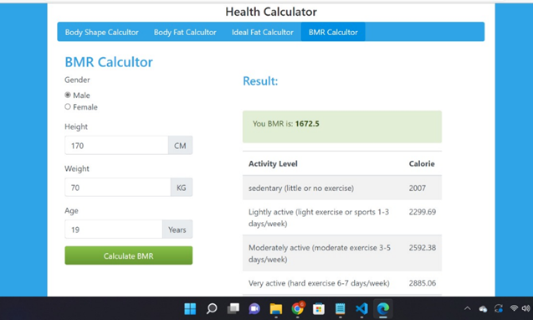

Slide 17



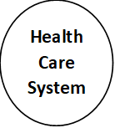









Data Flow Diagram

Slide 18
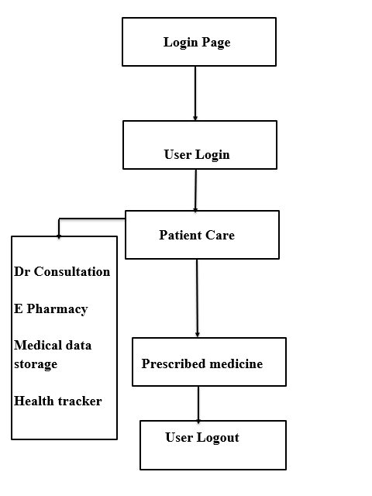
Flowchart
Fig : 3

Slide 19
Result and Discussion
The results based on the services available for the users, the systems of E-healthcare mainly split into three kinds:
1. The information of E-Health services and tools for people: - provide data during electronic health portals.
2. administrative of E-Health support services and tools for many people: – In order that provide service of health to users rather than providing electronic data such as ePrescription, administration, and e-Results.
3. Home care and telemedicine services and tools of E-Health for people.

Slide 20
Conclusion
So this project is an integration of all health services in a single website for the ease of the customer .
This business idea can bring a great change in medical field for ailments.
Our system has no boundary of the user because everyone can use this system.

Slide 21
Reference
Kreps GL, Neuhauser L. New directions in eHealth communication: Opportunities and challenges. Patient Educ Couns. 2010;78:329–36
E. Kyriacou, M.S. Pattichis, C.S. Pattichis et al., "m-Health e-Emergency Systems: Current Status and Future Directions", IEEE Antennas and Propagation Magazine, vol. 49, no. 1, pp. 216-231, 2021.
V. Ramani, T. Kumar, A. Bracken, M. Liyanage and M. Ylianttila, "Secure and Efficient Data Accessibility in Blockchain Based Healthcare Systems," 2020 IEEE Global Communications Conference (GLOBECOM), 2020, pp. 206-212, doi: 10.1109/GLOCOM.2018.8647221.
Berman, P (2020). ‘The Impoverishing effects of health Care payments in India: New methodology and findings’. Economic and Political weekly 27(16): 65-71.

Slide 22
Future Scope
The system provides simple access of relevant information to the organizations like the Medicaid and Medicare.
Well-being and care delivery: These will be the most health-focused of the three groupings, made up of care facilities
The symptom checker feature can be made more dynamic through the integration of extensive AI and machine learning that learns based on the subsequent diagnosis by the doctor after the patients complete their appointments. Future work will concentrate on addressing these constraints and expanding on our work.

